Slide 1

IoT-Based Smart Attendance Management System
Using RFID, NFC, or Sensor-Based User Authentication
Automating attendance tracking with secure, real-time identification and centralized monitoring
PUDI LOKESH
323129520110

Slide 2

Problem Statement
Inefficient Records
Time-Consuming Process
Manual registers and paper-based records are error-prone and slow down administrative processes.
Manual recording delays administrative workflows and wastes valuable time.
Proxy Attendance
Human Error
Fraudulent attendance undermines system integrity and data reliability.
Inaccurate data entry compromises the integrity of attendance records.
No Real-Time Visibility
Need for Automation
Lack of real-time monitoring leaves administrators without instant attendance insights.
Organizations require an automated, accurate, secure, and intelligent attendance solution.

Slide 3
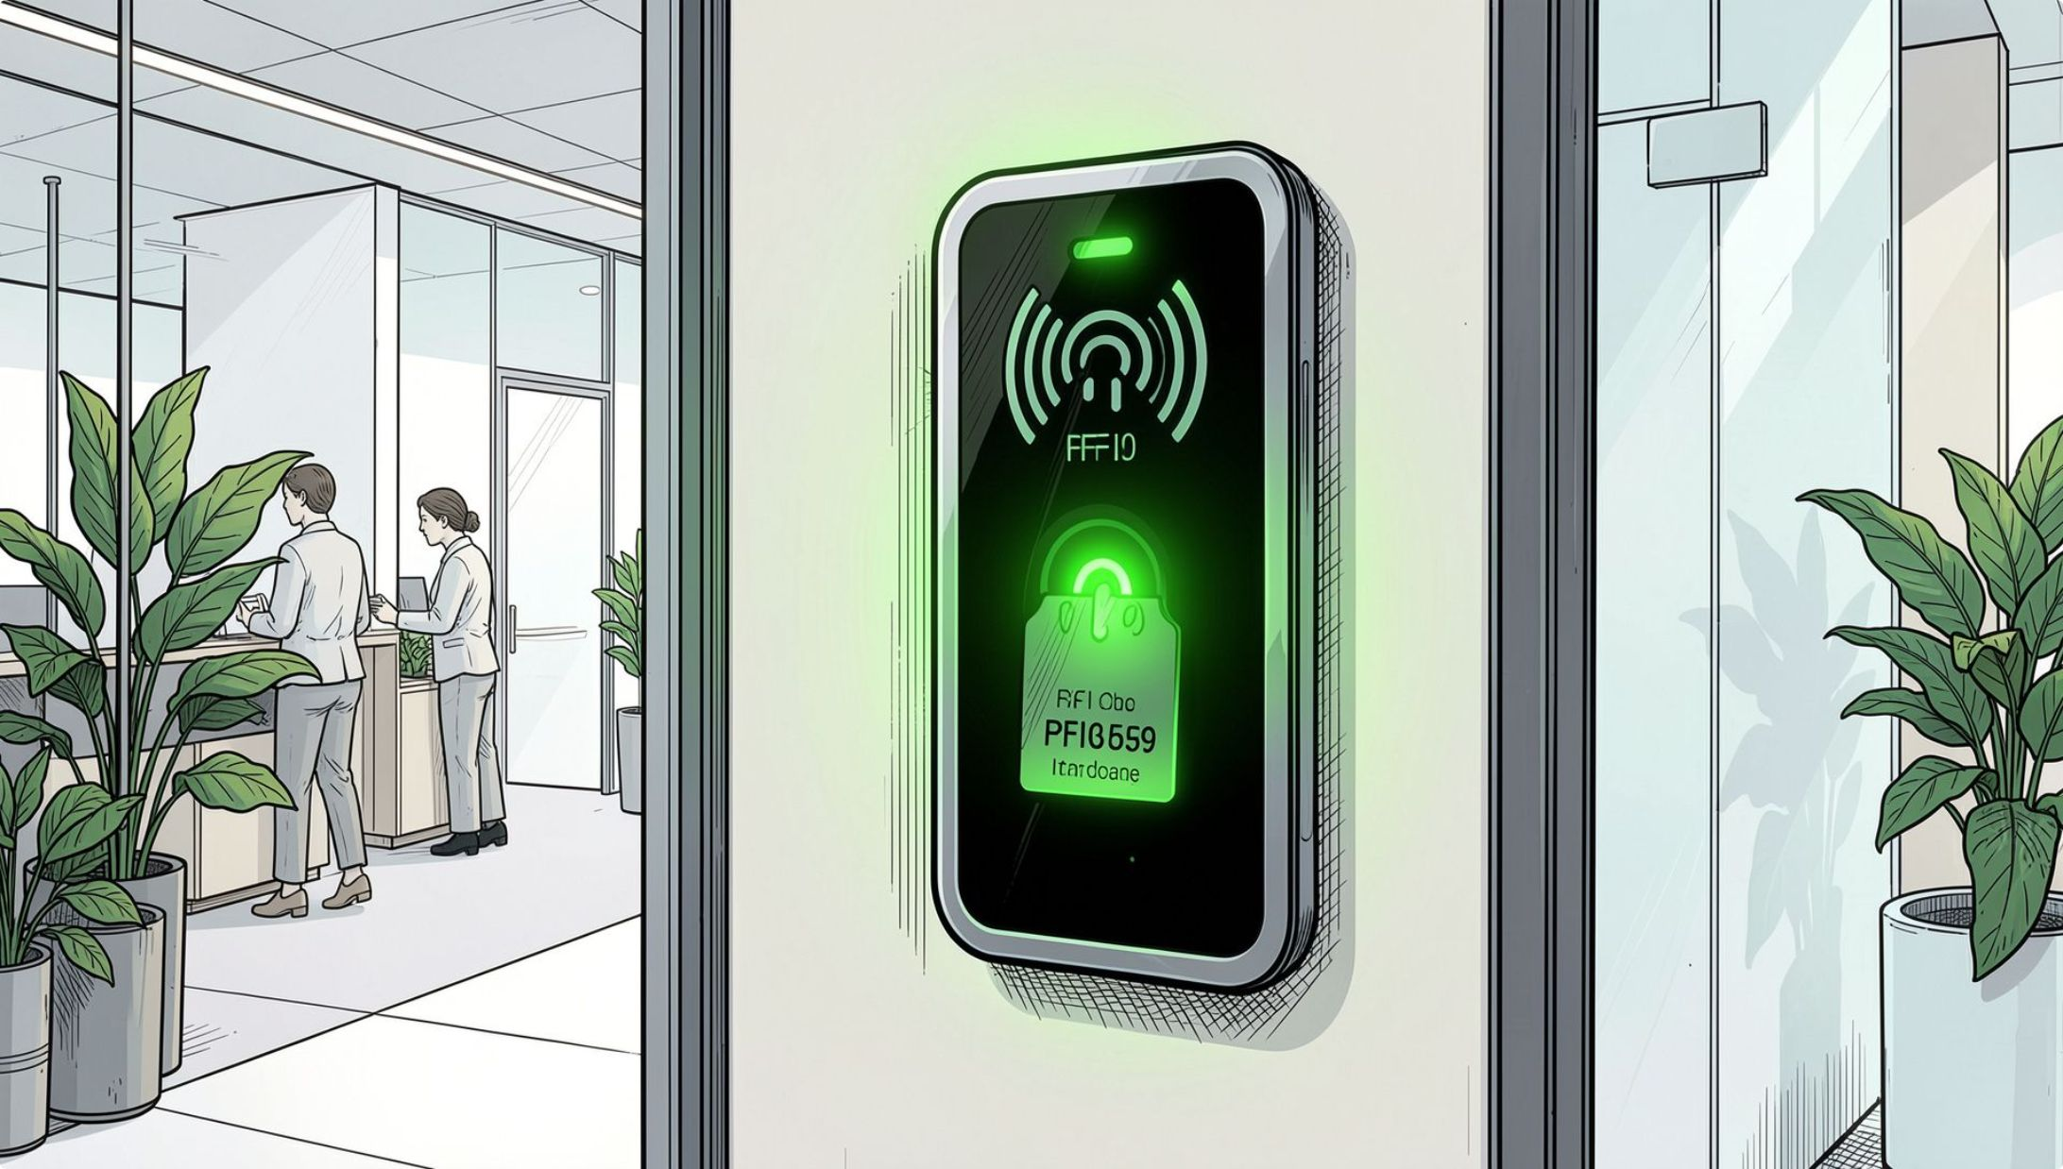
Proposed Solution
Automated Recording
Eliminates manual entry — attendance is captured instantly and accurately.
Multi-Modal Authentication
RFID, NFC, or sensor-based methods identify authorized users securely.
Centralized Monitoring
All attendance data is collected, stored, and accessible through a unified platform.
Real-Time Updates
Instant data transmission ensures administrators always have current information.

Slide 4
Objectives
Automate Recording
Prevent Proxy
Eliminate manual attendance entry entirely.
Block unauthorized access and fraudulent attendance.
Secure Authentication
Real-Time Monitoring
Provide robust user verification mechanisms.
Enable instant attendance visibility and notifications.
Improve Accuracy
Generate Reports
Enhance data integrity and attendance record quality.
Produce accurate, detailed attendance reports automatically.

Slide 5
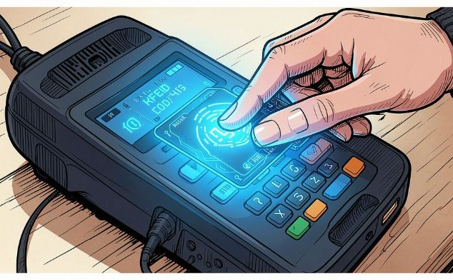
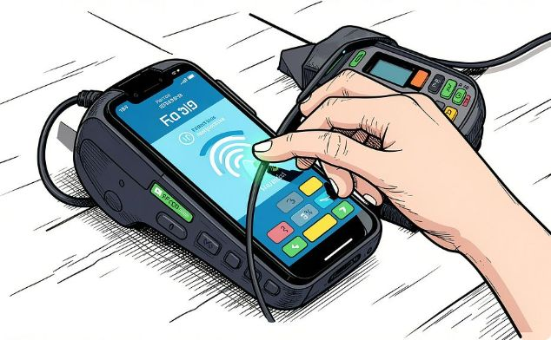
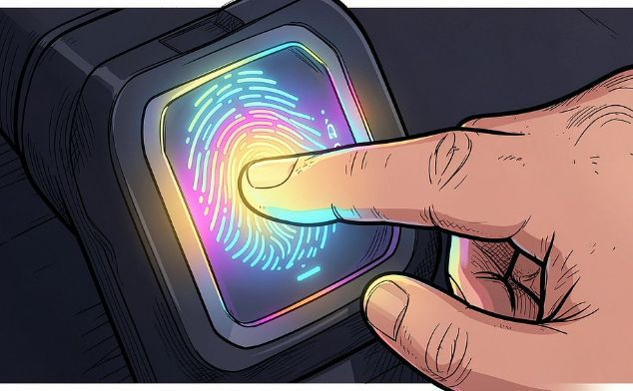

User Authentication Methods
RFID Technology
NFC Technology
Biometric / Sensor-Based
Identifies authorized users through RFID cards or tags read by dedicated RFID readers. Fast, contactless, and reliable for high-traffic environments.
Enables user identification through NFC-enabled smartphones or cards via short-range contactless communication. Convenient and widely supported.
Authenticates users using fingerprint, facial recognition, or other sensor-based methods. Highest security — no card or device required.
The system can utilize one or a combination of these methods for enhanced security and flexibility.

Slide 6
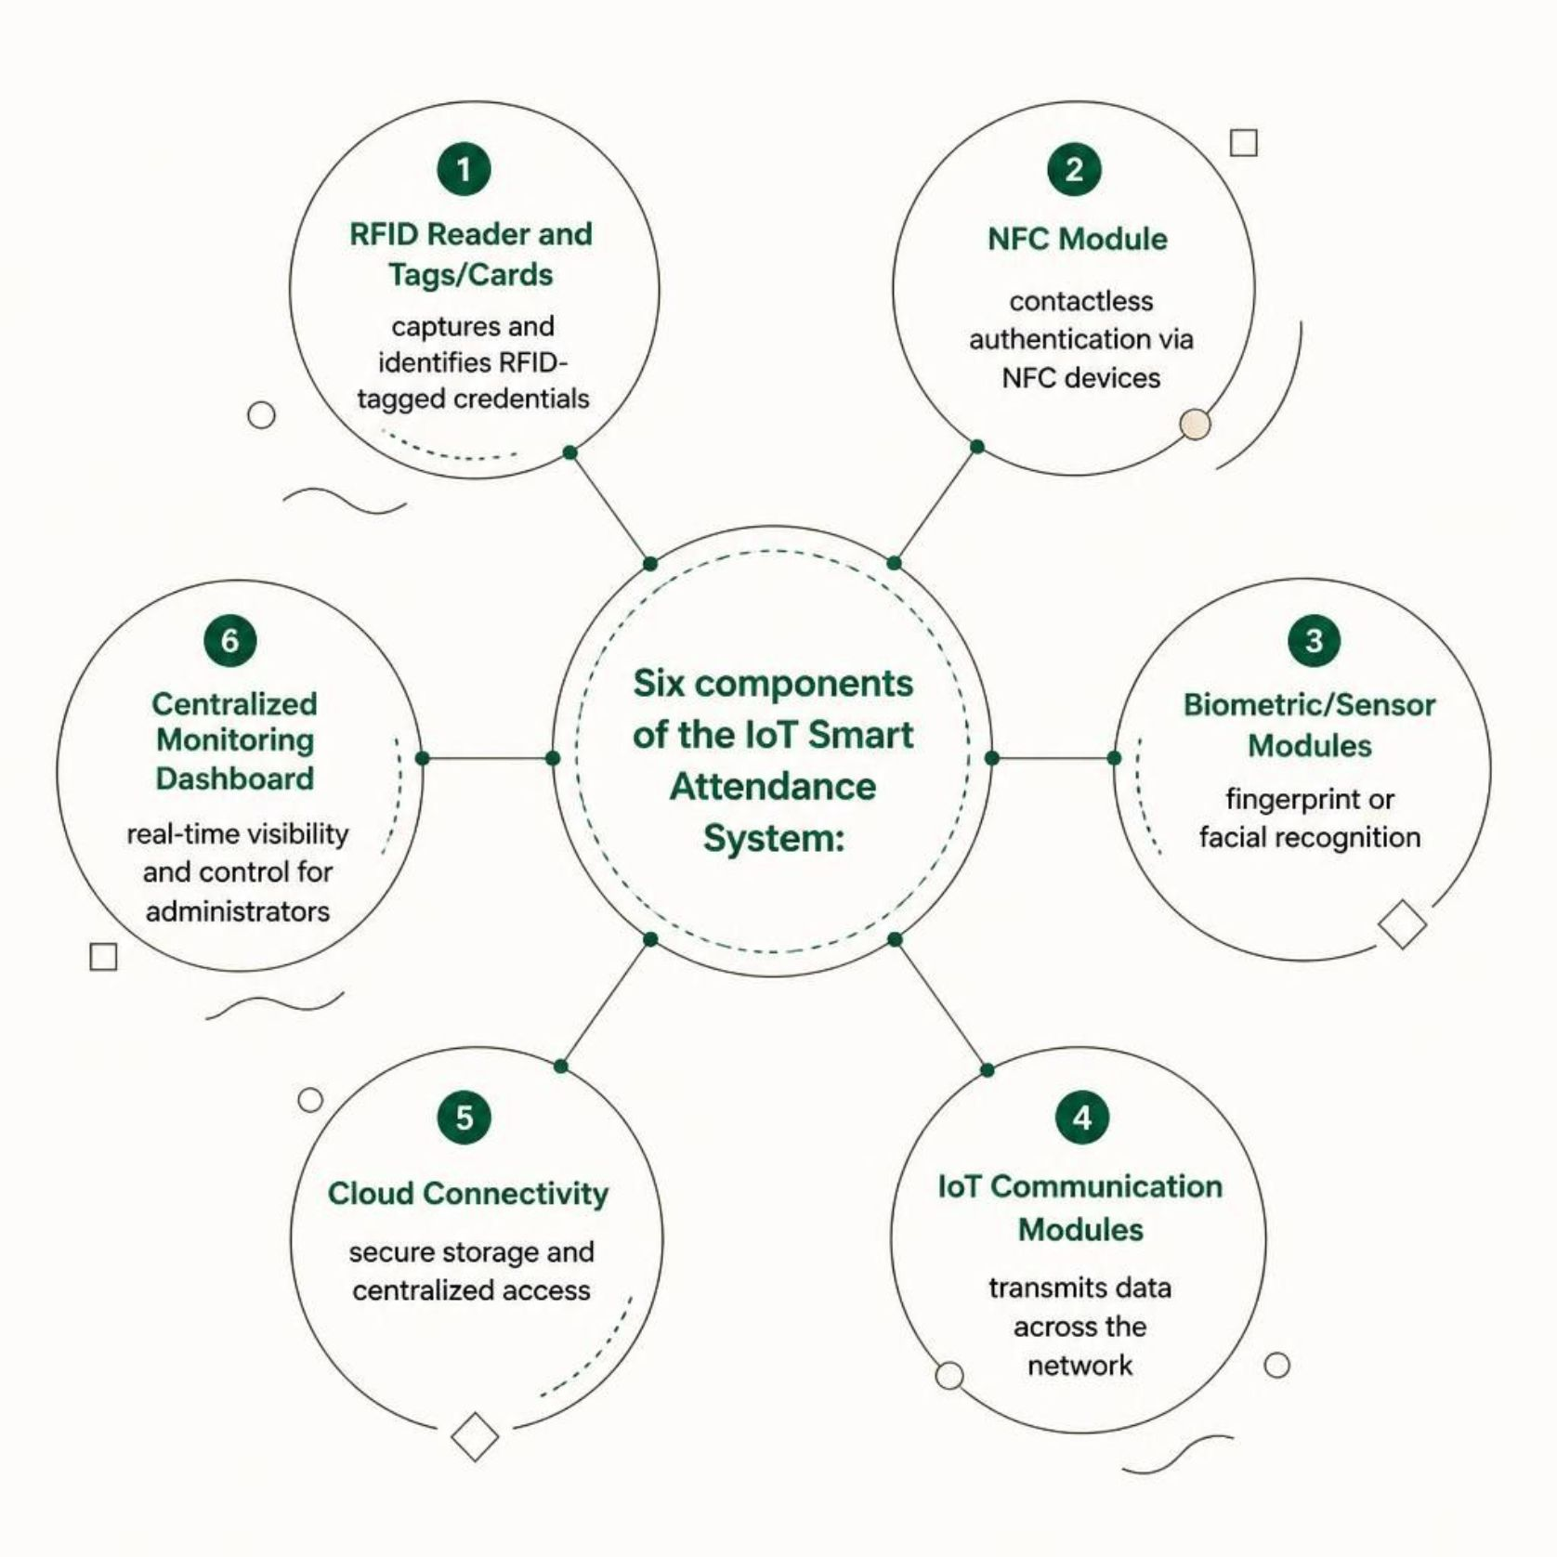
System Components
Hardware Layer
RFID Reader & Tags: Captures and identifies RFID-tagged user credentials
NFC Module: Contactless authentication through NFC-enabled devices
Biometric Sensors: Fingerprint or facial recognition modules
Connectivity & Software Layer
IoT Communication Modules: Transmit authentication and attendance data across the network
Cloud Connectivity: Secure data storage and centralized access
Monitoring Dashboard: Real-time attendance visibility and administrative control

Slide 7

Working Principle
Approach
Verification
User reaches authentication point
Credentials checked against database
Identification
Recording
RFID, NFC, or sensor detects user
Attendance entry recorded and timestamped
The end-to-end workflow ensures every authentication event is captured, verified, timestamped, and made instantly available to administrators — with no manual intervention required at any stage.

Slide 8
Dashboard and Monitoring
Attendance Records
Authentication Logs
Complete history of user check-ins and check-outs with full audit trail.
Detailed logs of all authentication attempts, successes, and failures.
Entry & Exit Times
Real-Time Alerts
Precise timestamps for every arrival and departure event.
Instant notifications for unauthorized access attempts or anomalies.
Attendance Statistics
Custom Reports
Aggregated data on attendance patterns, trends, and summaries.
Customizable attendance reports for analysis and compliance needs.

Slide 9

Benefits and Applications
Key Benefits
Improved accuracy and elimination of proxy attendance
Reduced administrative workload and faster recording
Secure authentication with real-time monitoring
Better record management and accurate report generation
Where It Can Be Deployed
Schools
Colleges & Universities
Corporate Offices
Industries
Training Centers

Slide 10

Conclusion
Intelligent Automation
IoT-based system replaces inefficient traditional attendance methods with seamless, intelligent automation.
Secure Authentication
RFID, NFC, or sensor-based authentication enables secure and automated user identification at every touchpoint.
Centralized & Real-Time
IoT and cloud connectivity support centralized, real-time attendance management accessible from anywhere.
Empowered Administration
Dashboards and instant notifications empower administrators to monitor and act on attendance data efficiently.
Smart attendance management drives operational excellence and organizational success.

